Slide 1
Military Institute of Science and Technology (MIST)
Department of Computer Science and Engineering (CSE)
System Modeling
CSE 360
Integrated Design Project/Capstone Project-II
Credit Hr. 1.50, Contact Hr. 3.00
Lec Tarannum Zaki
Dept of CSE
MIST

Slide 2
OUTLINE
Context diagram
Use-Case diagram
Sequence diagram
Activity diagram

Slide 3
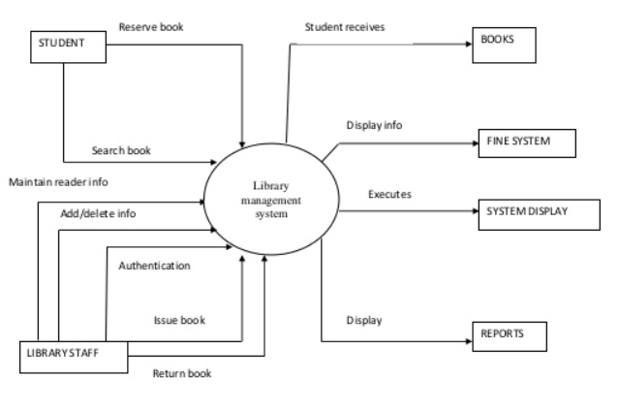
Context diagram

Slide 4
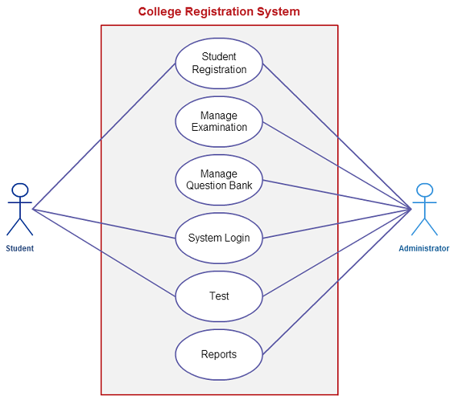
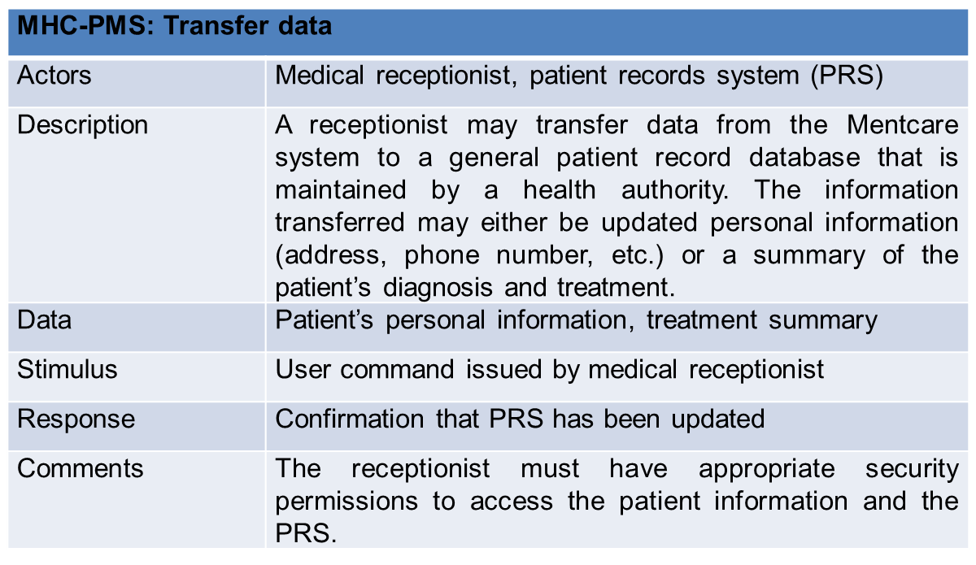
Use-Case diagram

Slide 5
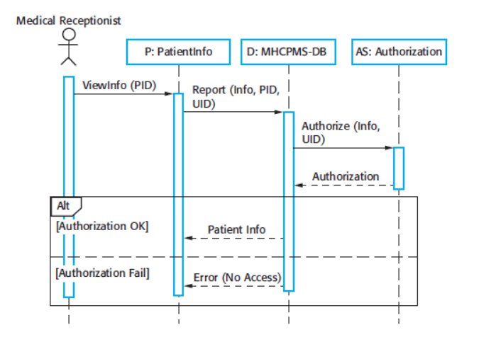
Sequence diagram

Slide 6
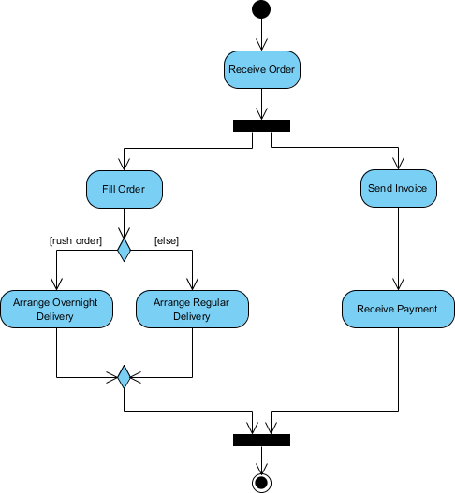
Activity diagram

Slide 7
Tasks
Context diagram - one
Use-Case diagram – minimum two
Sequence diagram – minimum two
Activity diagram – minimum two

Slide 8
THANK YOU

